Slide 1
ECE 105: Introduction to Electrical Engineering
Lecture 20
Optical Communications
Yasser Khan
Rehan Kapadia

Slide 2



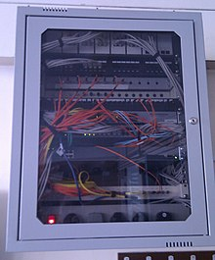
How have we done optical communications in the past?
What kind of systems have people used in the past to do optical communications?
Smoke Signals
Signal Lamp
Heliograph
Fiber Optics

Slide 3
How fast could we communicate using smoke signals?
We could have a short or long pulse to represent a 1 or 0.
Let’s assume 0.5 seconds for short and 1.5 seconds for long pulse
The gap between the pulses needs to be at least 0.5 seconds for it to be seen
That means that we would need 0.5+0.5 to send out a short pulse
We would need 1.5+0.5 to send out a long pulse
Average time to send a bit = (Short + Long)/2 = 1.5 s
Our bitrate is 1 bit/1.5s = 0.66 bps

Slide 4
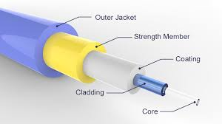
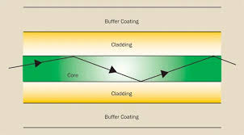
Optical Fiber
Optical fibers guide light from one point to another confined inside a fiber core.
These work based on the principle of total internal reflection. Depending on the angle that light hits the fiber/cladding interface, it can be fully reflected

Slide 5
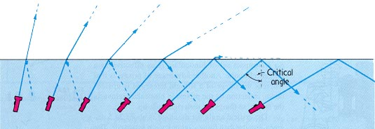
Total internal reflection
When light moves from a medium of high refractive index to a medium of low refractive index, or vice versa, there is a change in the angle of propagation of light.

Slide 6
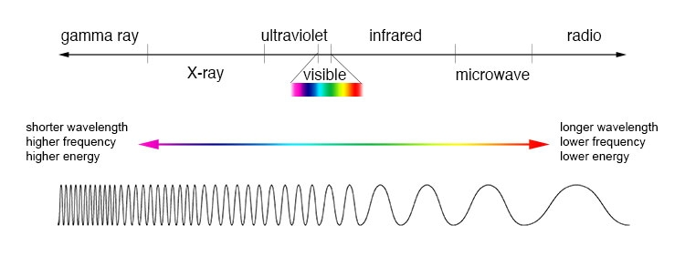
General properties of light
The wavelength of light represents the spatial dimension over which it is periodic

Slide 7
Speed of light in different mediums
There is a concept called the refractive index, which is:
n = c/v
Where
n: refractive index
c: speed of light
v: speed of light in the medium
This emerges due to the oscillations of electrons in a material creating dipoles that interact with electromagnetic waves and slow them down

Slide 8
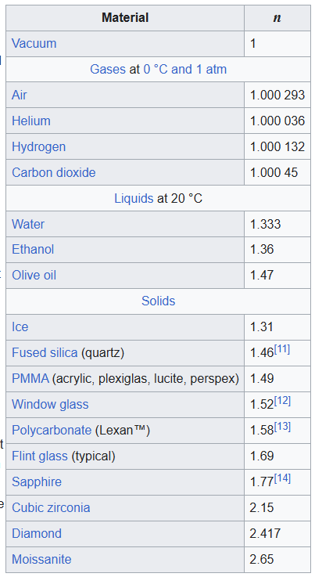
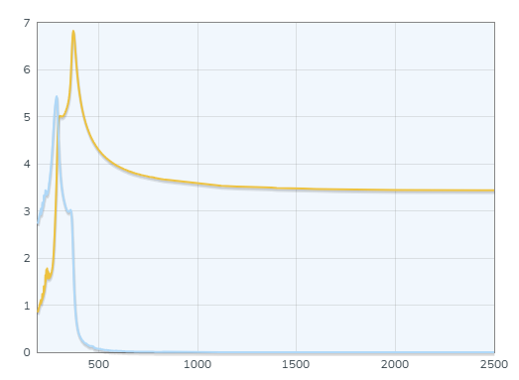
Refractive index of different materials
The refractive index is a function of material AND wavelength of the electromagnetic radiation
Si
RI or EC
Refractive Index
Extinction Coefficient
Wavelength (nm)

Slide 9
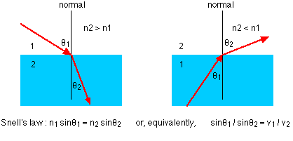
Snell’s Law
Snell’s law gives us the relationship between the angle of light in one medium with respect to normal and the angle of light in another medium with respect to normal when an interface is crossed at an angle.

Slide 10
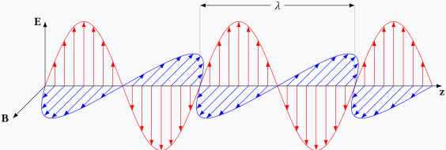
Polarization of light
Wavelength
Electromagnetic waves have an electric field and magnetic field that oscillate in orthogonal planes.
The polarization of light indicates the plane in which the electric field is oscillating

Slide 11
s-polarization and p-polarization
Depending whether the polarization is in plane or orthogonal to the interface
p-polarized light has the electric field in plane or parallel with the interface
s-polarized light has the electric field orthogonal or perpendicular to the interface

Slide 12
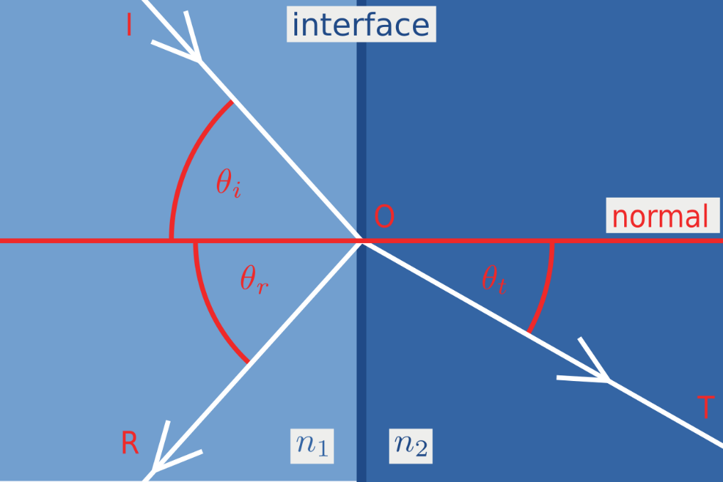
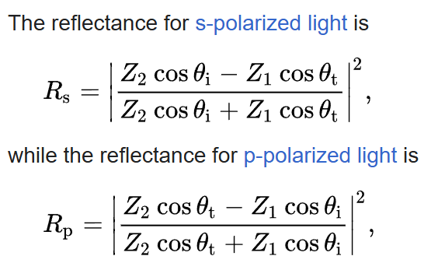
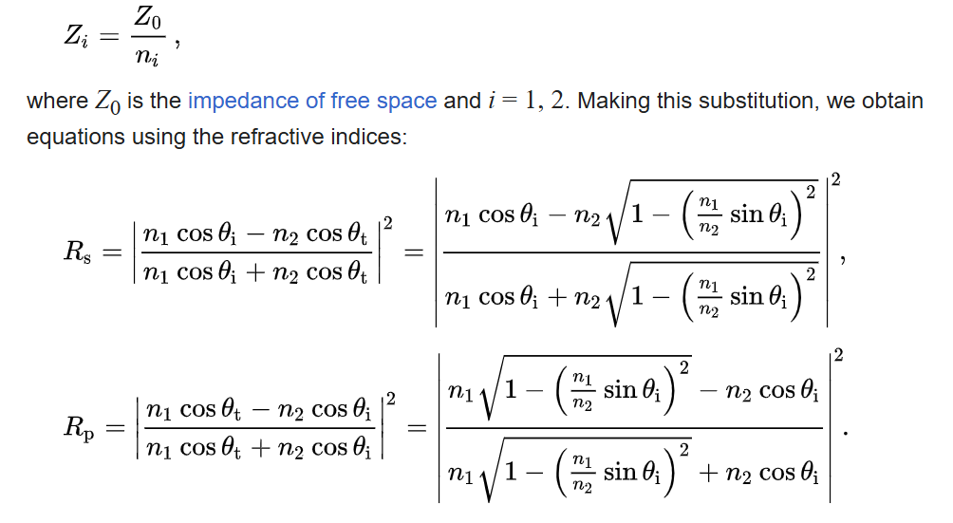
Transmission and Reflection
S-Polarized Light
P-Polarized Light
Snell’s law gives us the relationship between the angle of light in one medium with respect to normal and the angle of light in another medium with respect to normal when an interface is crossed at an angle.

Slide 13
Transmission and Reflection
Snell’s law gives us the relationship between the angle of light in one medium with respect to normal and the angle of light in another medium with respect to normal when an interface is crossed at an angle.

Slide 14
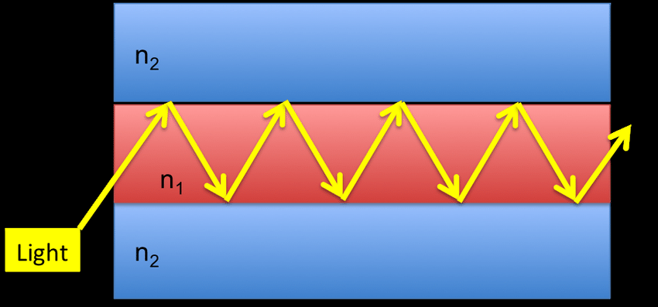
Waveguides
If light is incident on an interface at an angle beyond the critical angle, then it is reflected back. It will also be incident on the lower surface at an angle that enables total internal reflection. This allows us to create a waveguide, where light will just propagate in a confined guide as long as possible.

Slide 15
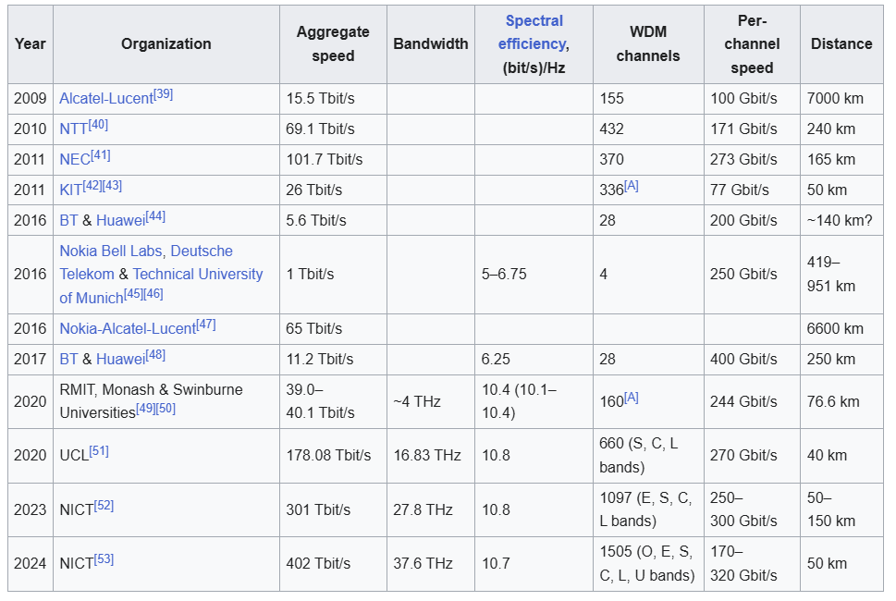
Optical Fiber Transmission Speeds

Slide 16
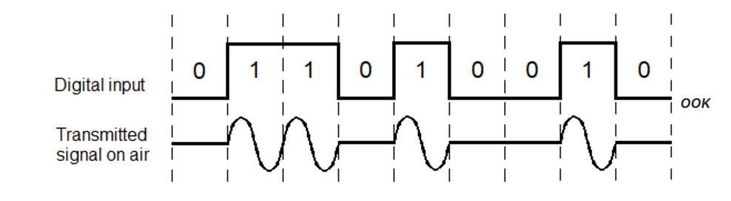
Optical Modulation Techniques
Intensity Modulation: Where you modulate the intensity of the light, and have predetermined values for each intensity of light.
On-off keying is where you have two values that represent 1 and 0, allowing you to transmit binary information

